Slide 1
BLOCKPARTY
2018.03.29
Seoul, Korea
Ling Qing Meng
Fr8 Network ling@fr8.network

Slide 2
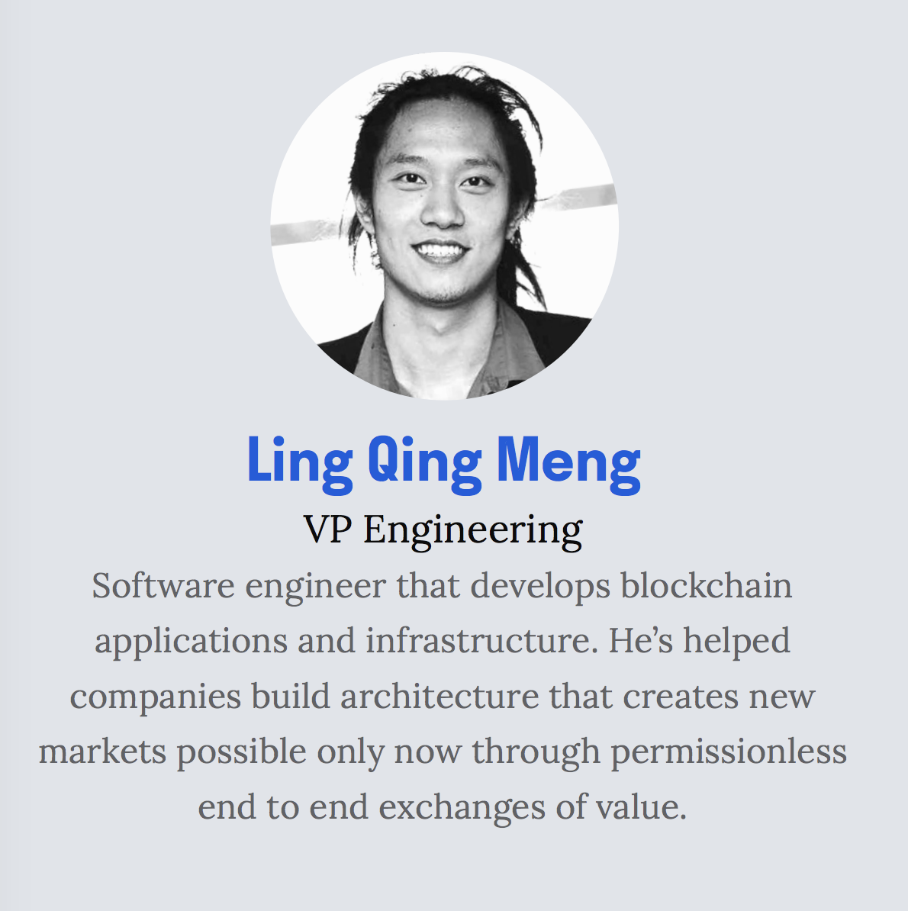
HELLO!
I am Ling Qing Meng
I am here to teach about how to deploy Ethereum Contracts.
https://t.me/lingqingmeng
@lingqingmeng

Slide 3
1.
Metamask Wallet
Getting started with Metamask, an open source chrome extension that is your client-side interface to the Ethereum Blockchain.
Notes:
Introduce Metamask: Less than 20 seconds
Most people use it for sending Ether to their friends and to ICOs.
Metamask is most importantly a developer tool. It’s a chrome extension.
That handles user authentication for you and your business. It automatically prompts you for permission.

Slide 4
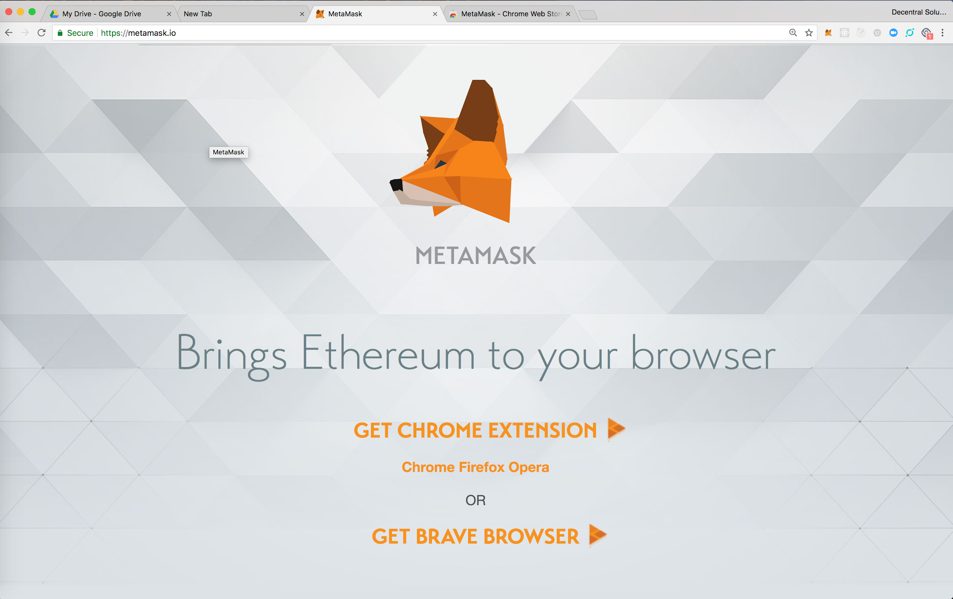
https://metamask.io
DEPENDENCIES
Google Chrome and Metamask
Go to metamask.io
Install extension
Accept terms of use
Rinkeby Ether
Remix IDE
Notes:
What is metmask: An infura connected light wallet. Infura is connected with Geth and Parities.
Why metamask: Can sign transactions without having to sync up your node. It’s expensive, using over 200 GB on your macbook. Or pay extremely high AWS costs.
How does metamask work: MetaMask injects web3 object and convenience Web3.js library into the javascript context. Look for this before using your fallback strategy (local node / hosted node + in-dapp id mgmt / read-only / fail).

Slide 5
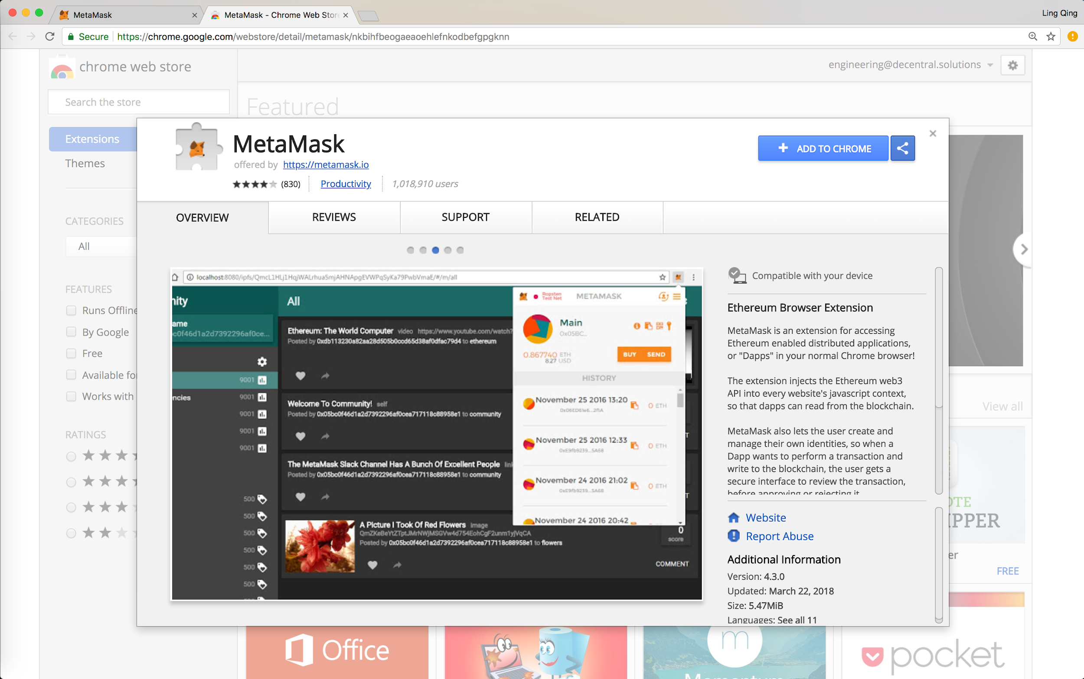
https://metamask.io
DEPENDENCIES
Google Chrome and Metamask
Go to metamask.io
Install extension Accept terms of use
Rinkeby Ether
Remix IDE
Notes:
This should take a few seconds. Install it and just accept all the user terms and default values in the installer. Just do it.

Slide 6
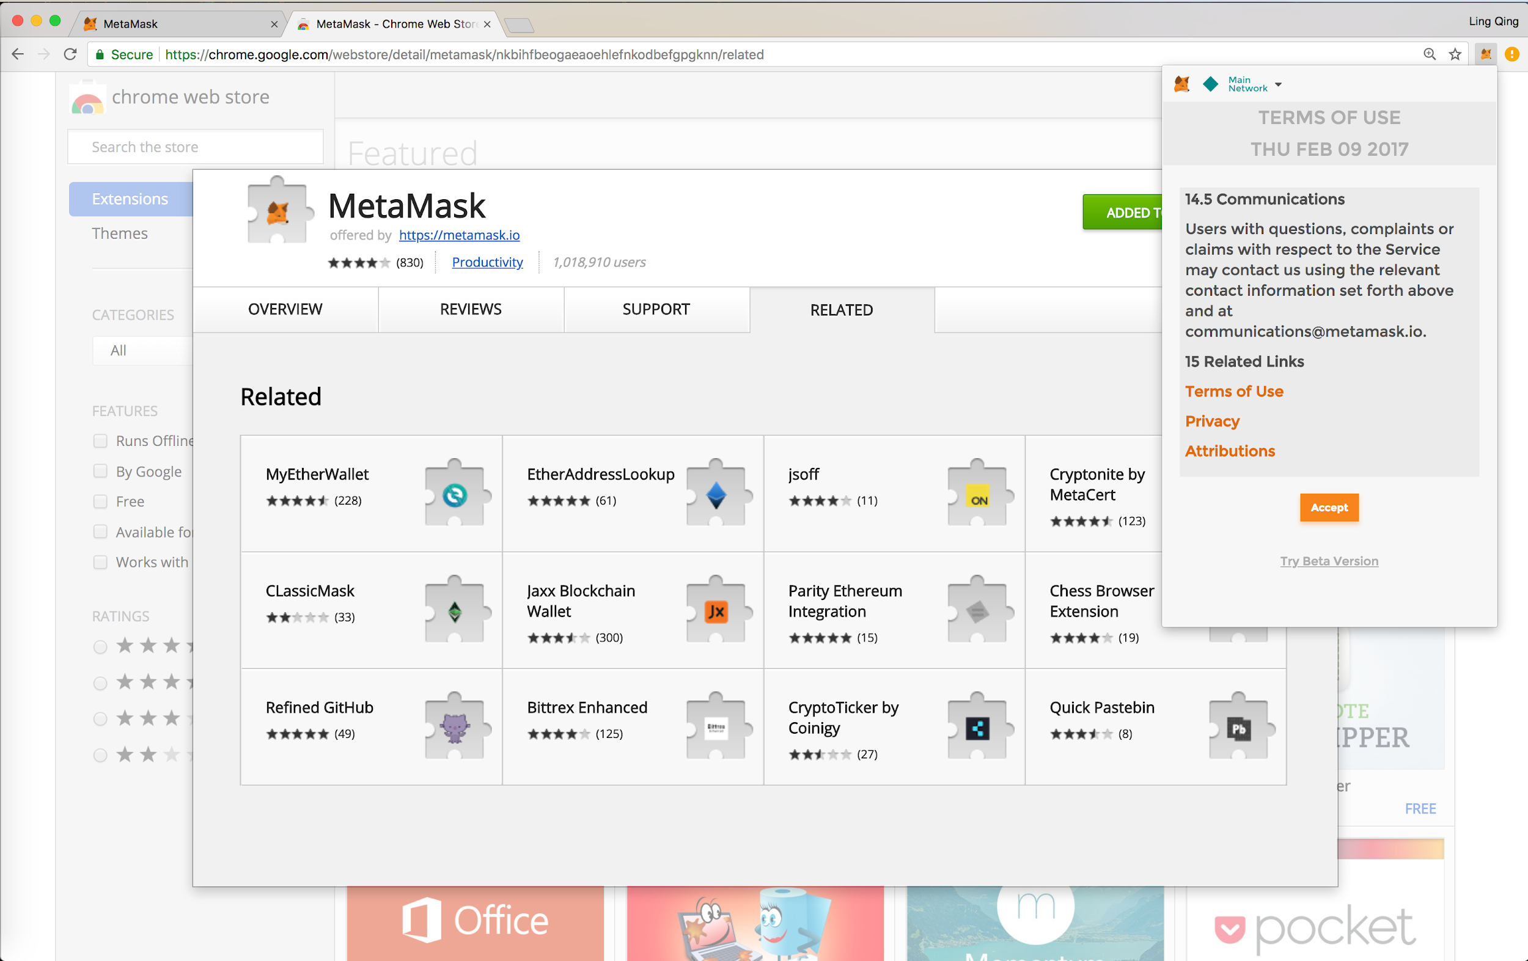
https://metamask.io
DEPENDENCIES
Google Chrome and Metamask
Go to metamask.io
Install it
Accept terms of use
Rinkeby Ether
Remix IDE
Notes:
Take like 5 seconds on this slide

Slide 7
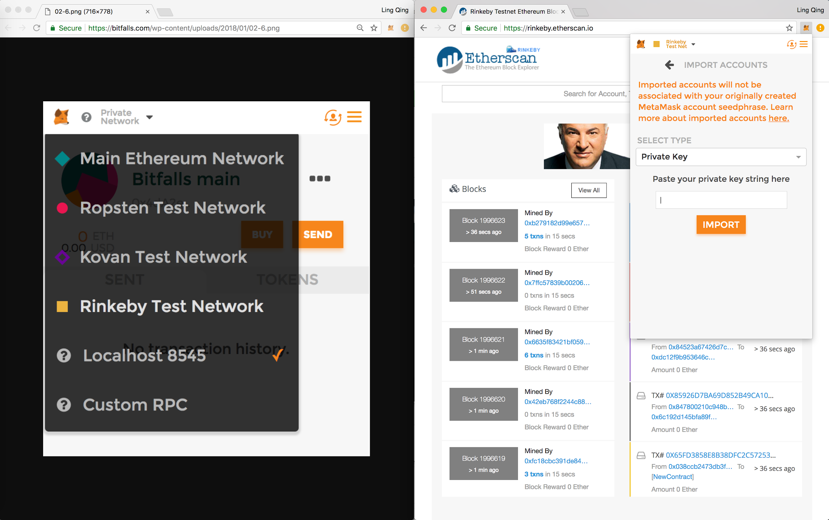
DEPENDENCIES
Google Chrome and Metamask
Rinkeby Ether
Import Private Key
Go to Remix
Set Environment to
Injected Web3
(Rinkeby)
Remix IDE
Notes:
You need Ether to deploy. We have given you guys all accounts preloaded with Rinkeby Ether.
You need this to deploy
This is testnet ether. You need testnet ether to deploy. It’s better than using mainnet ether since it can get expensive.
This isn’t normally how you would do it. You can get free testnet ether by going to a website, verifying a twitter post and capcha, and which acocunt for it to load

Slide 8
HOW IT FITS INTO OUR PROCESS
Expose Javascript API on the Client
IDE compiles
Solidity source code to bytecode
Bytecode is sent as transaction to persist into the global state
Notes:
Metamask, while using web3 API turns your solidity code (the .sol file) into machine readable bytecode. The chrome extension has an event listener, lets say you hit “Deploy this contract”, and the web3 API knows that it needs gas, and it knows who the current default account is. That is you (the client). Now it asks, okay where’s my money for this transaction. Metamask, when you first create an account, specifies a password for you to set. That password allows the ciphertext of the private key to be used to sign the transaction, against the default account.
Now that the transaction has been sent to the nodes (Geth and Parity, it gets processed to be included on the next block).

Slide 9
RECAP
To deploy, you need to pay Gas (Ether).
Metamask is a wallet and manages your private keys and signs your transactions.
It injects web3 into your Javascript runtime, which is the interface to the blockchain.
Your browser now has access to the same API that every Ethereum and JS engineer uses.
Notes:
Everyone here should know how Javascript and Browsers work. The client is metamask, which is written in Javascript. The client exposes web3, a javascript API library. That library contains cryptographic functions. In order to send money on the blockchain, you need to sign a transaction with your private key. Your private key is what you imported in.

Slide 10
2.
REMIX IDE
The Jsfiddle for Solidity
Zero setup interface with web3, solc compiler, client wallet

Slide 11
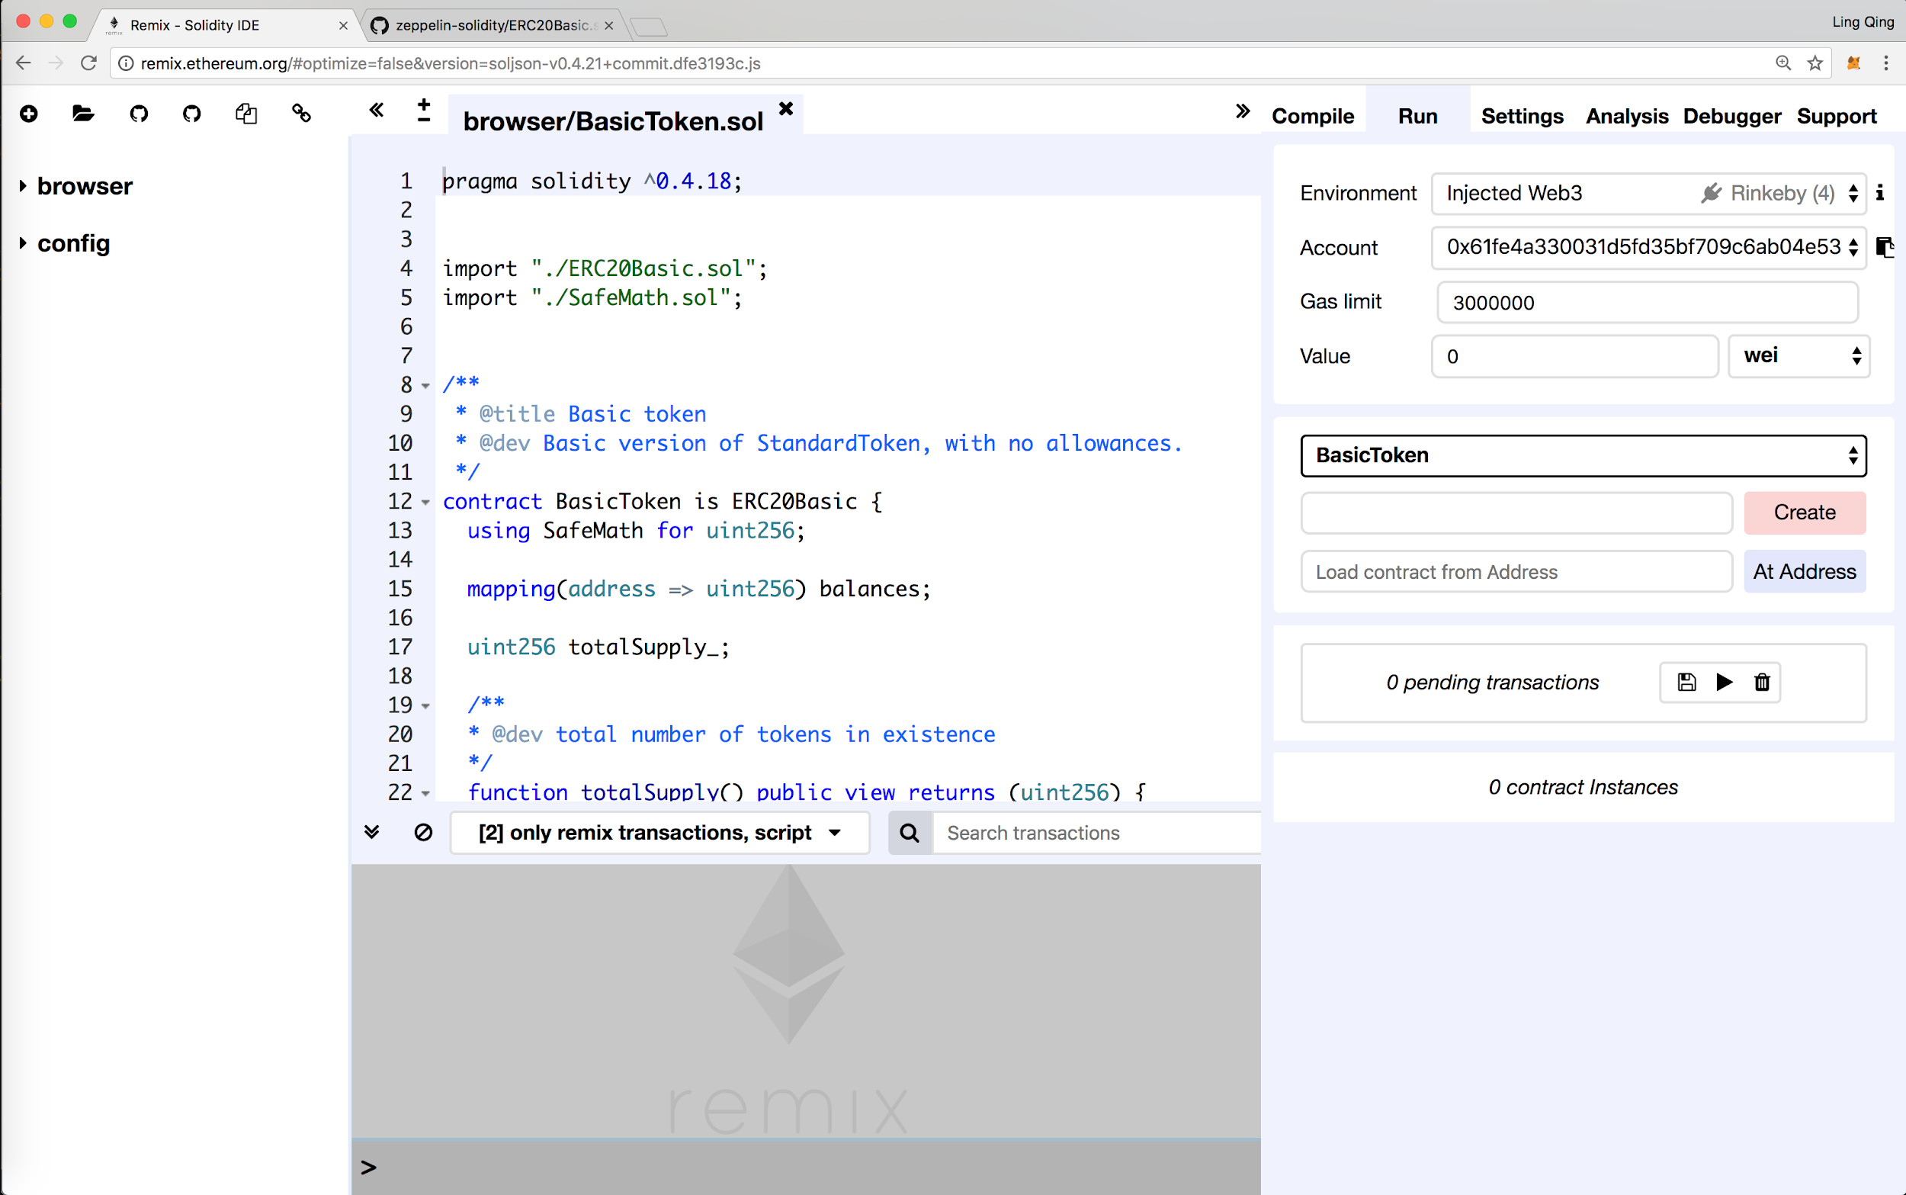
http://remix.ethereum.org
DEPENDENCIES
Google Chrome and Metamask
Rinkeby Ether
Import Private Key
Open Remix IDE in
new tab
Set Environment to
Injected Web3
(Rinkeby)
Remix IDE

Slide 12
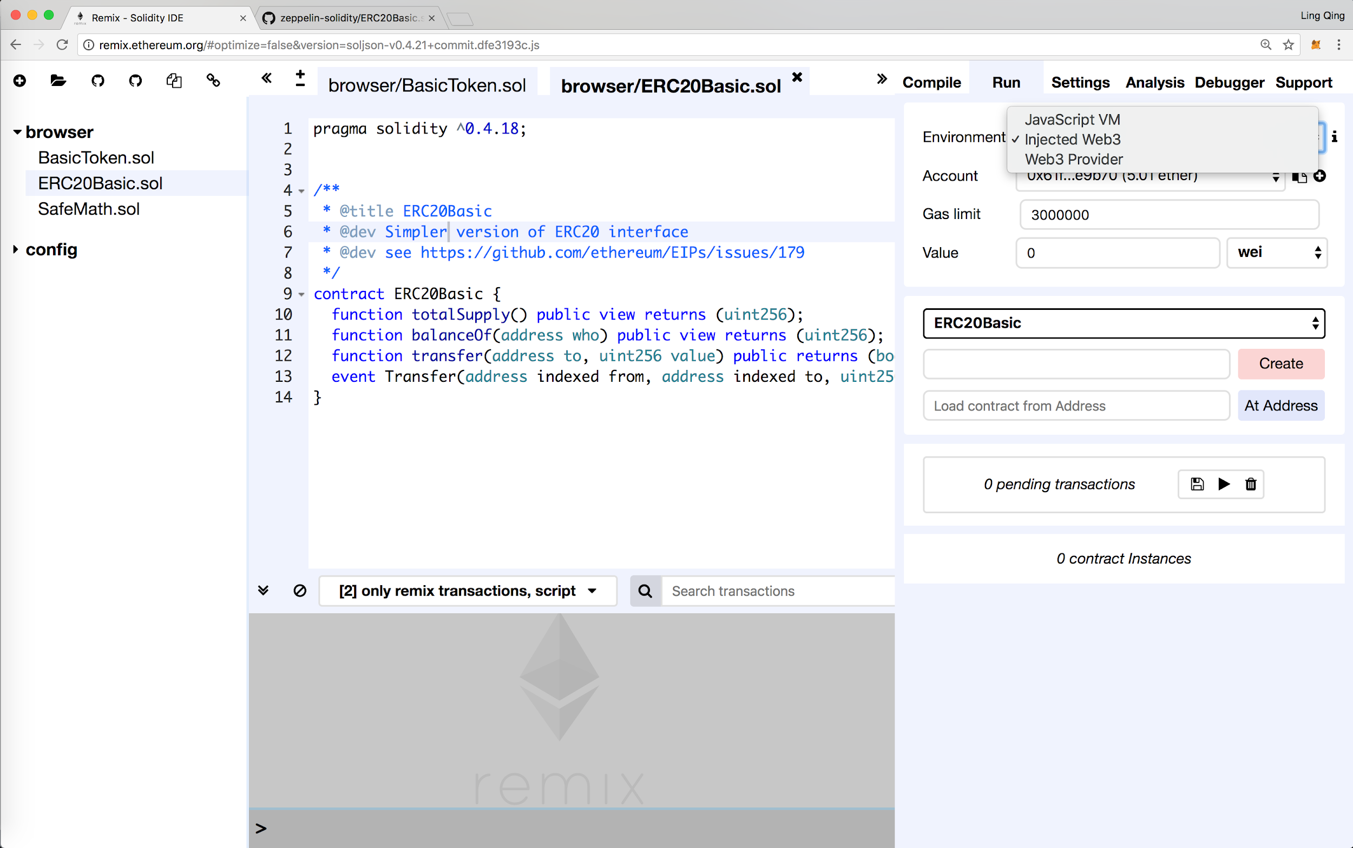
http://remix.ethereum.org
DEPENDENCIES
Google Chrome and Metamask
Rinkeby Ether
Import Private Key
Open Remix IDE in
new tab
Set Environment to
Injected Web3
(Rinkeby)
Remix IDE

Slide 13
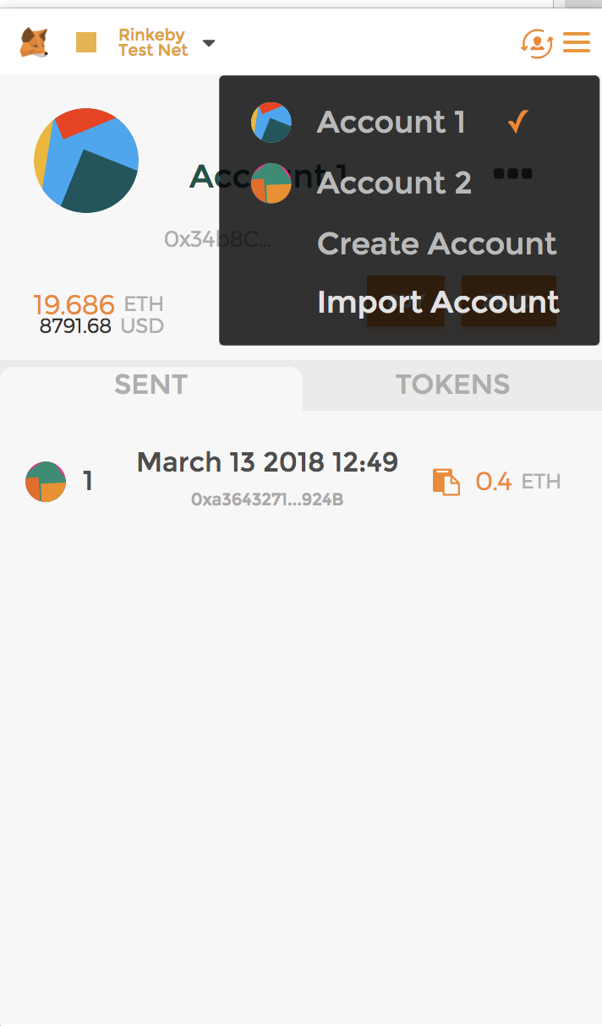
HOW TO GET RINKEBY ETHER
Find your name and private key
https://goo.gl/eYZ7HW
Open Metamask in your Chrome
Click the top right Profile Icon.
Select Import private key in dropdown.
Paste Private Key
Paste Private Key.
Click button Import. Confirm your public key matches.
Notes:
You need this to deploy
This is testnet ether. You need testnet ether to deploy. It’s better than using mainnet ether since it can get expensive.
This isn’t normally how you would do it. You can get free testnet ether by going to a website, verifying a twitter post and capcha, and which acocunt for it to load

Slide 14
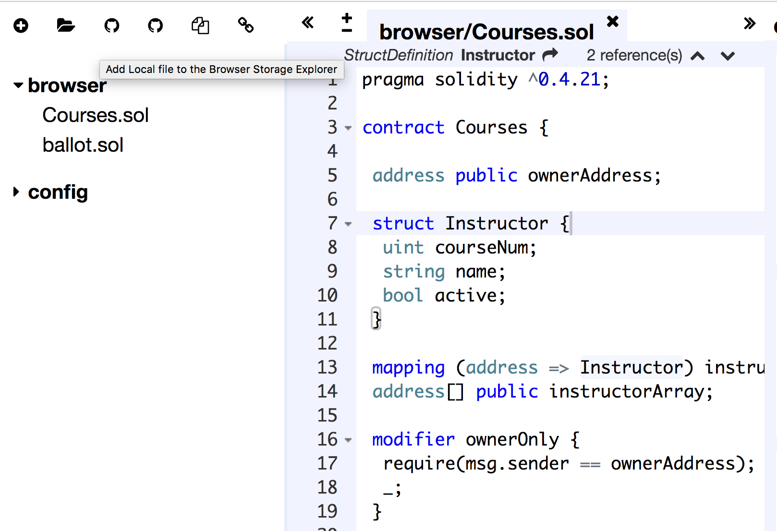
EXERCISE: DEPLOY TO RINKEBY TESTNET (1 of 2)
https://remix.ethereum.org/
Gist: https://goo.gl/pwGNbW
Copy Gist to clipboard, then in Remix hit the top left (+) button to add a file.
The new file must be named
Courses.sol
The filename, “class name” and constructor should all == and be the same case.
Compiler tab should show green.

Slide 15
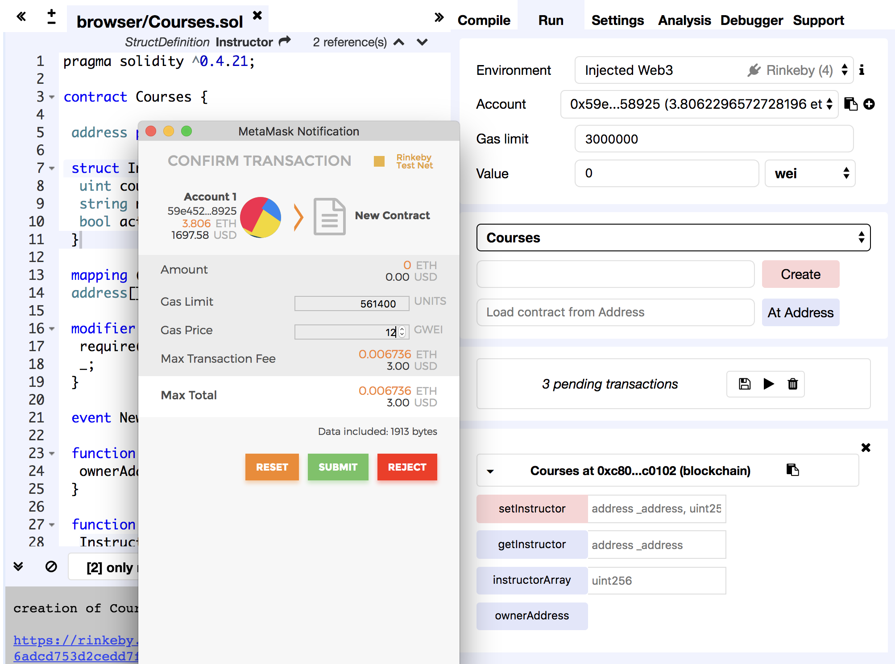
EXERCISE: DEPLOY TO RINKEBY TESTNET (2 of 2)
https://remix.ethereum.org/
Gist: https://goo.gl/pwGNbW
On right panel, change tab from Compile to Run.
Hit Create. This will prompt metamask to open.
Change input Gas Limit to 15.
Hit Submit. Confirm success output:
https://rinkeby.etherscan.io/tx/0x5cfbd9488e94bc90bbc15c8c28b575ceac55e6e0e349928dcbb461231972c15b
creation of Courses pending...

Slide 16
3.
TRUFFLE SUITE
Software Suite for Optimized Developer Performance
Gosu Solidity Devs Only

Slide 17
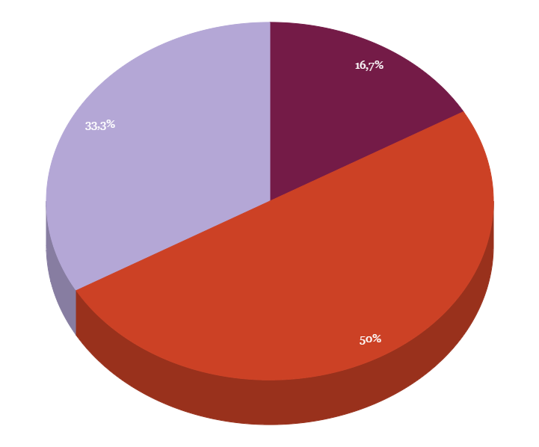
What’s Included:
TestRPC
Network Configuration
Continuous Integration
Solidity Unit Tests
Javascript Unit Tests
External Scripts
Many more
Debugger
Script Runner
CLI Tools Testing Compiling
Migrations
Notes:
Tell them why this will make them a better developer when you’re getting 3x more things done.

Slide 18
OPTIMIZED PROCESS FOR FULLSTACK DEVELOPMENT
Define Specs
Write Unit Tests and Solidity Code
Confirm tests pass against local TestRPC node (ganache-cli)
Deploy to staging, run migrations on live testnet (rinkeby), run integration tests

Slide 19
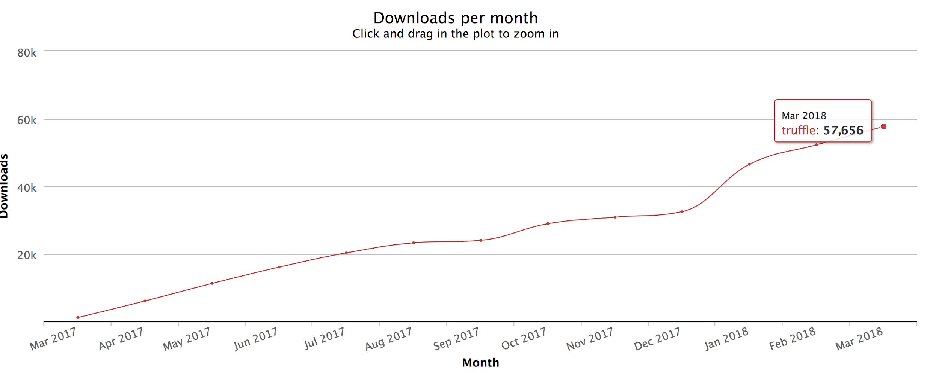
https://npm-stat.com/charts.html?package=truffle
npm install -g truffle
57,656 downloads per month

Slide 20
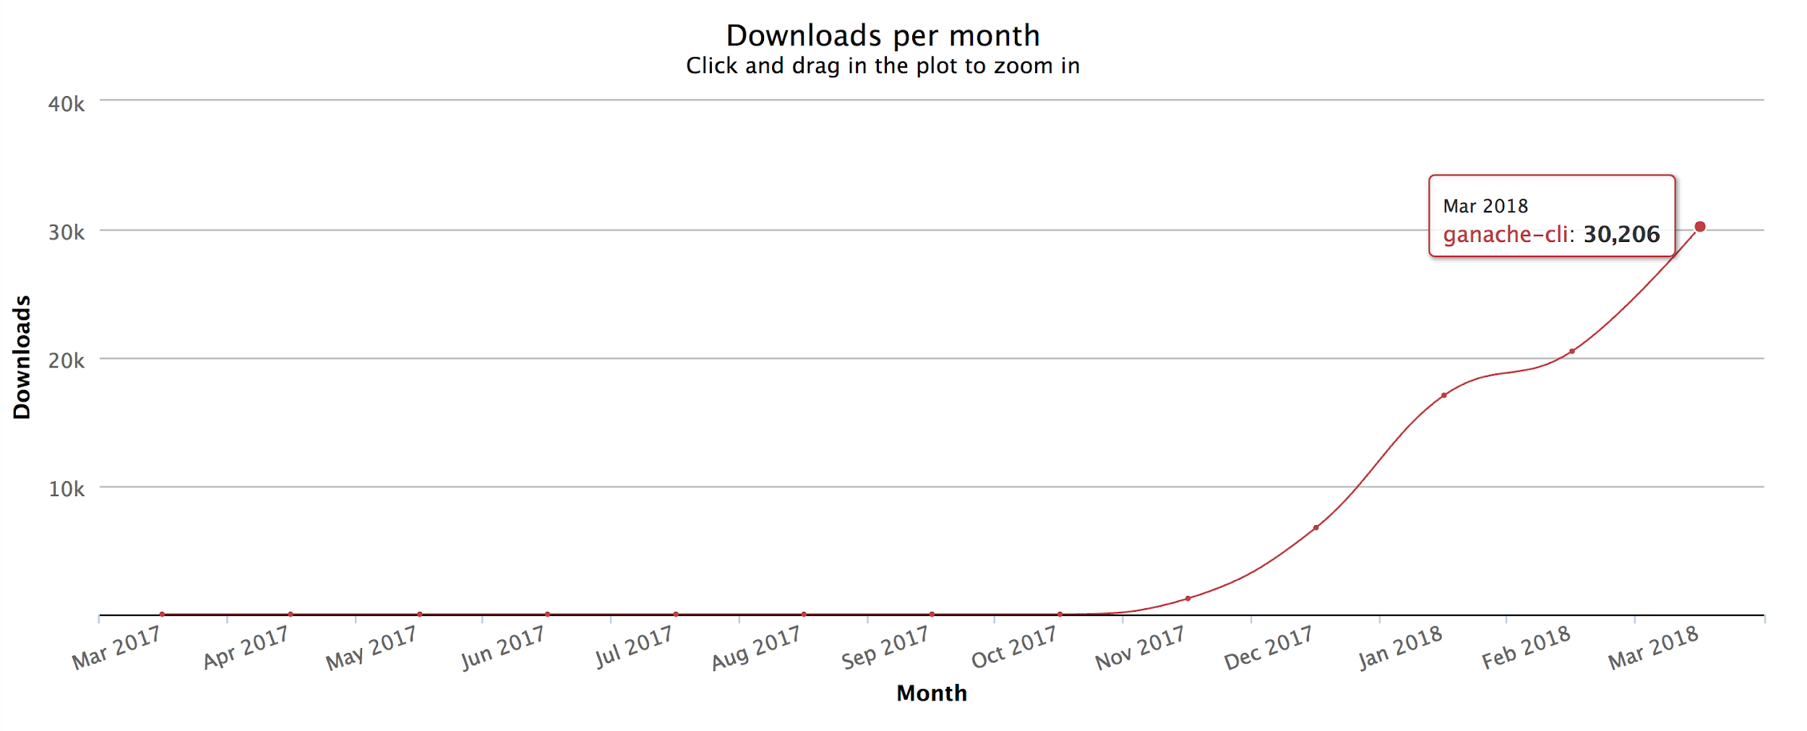
https://npm-stat.com/charts.html?package=truffle
npm install -g ganache-cli
30,206 downloads per month

Slide 21
MIGRATIONS WITH TRUFFLE
First, your account must be unlocked
Deployments cost gas, therefore transaction must be signed by your private key
Know the difference between unlocking a wallet vs signing a transaction.
Notes:
Unlocking a wallet is something you can do in Metamask, Geth and Parity.

Slide 22
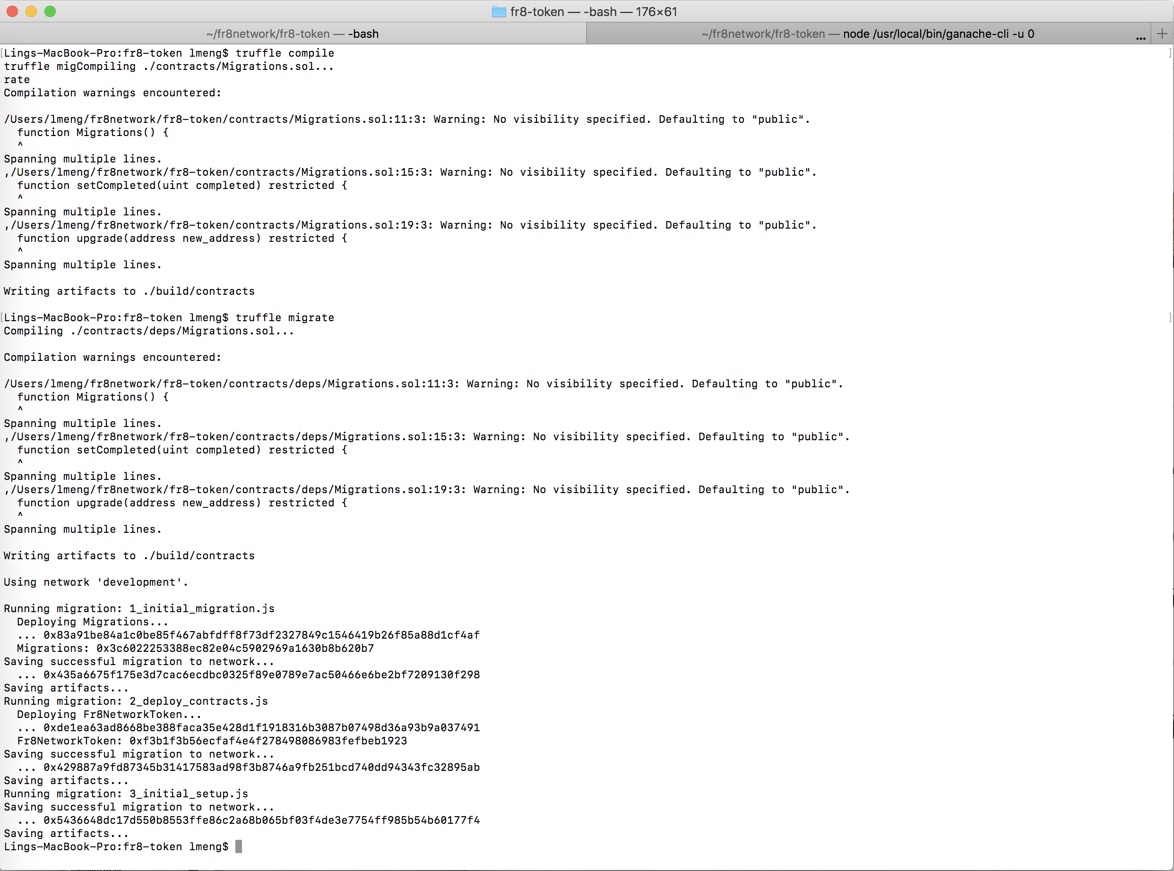
Notes:
Unlocking a wallet is something you can do in Metamask, Geth and Parity.

Slide 23
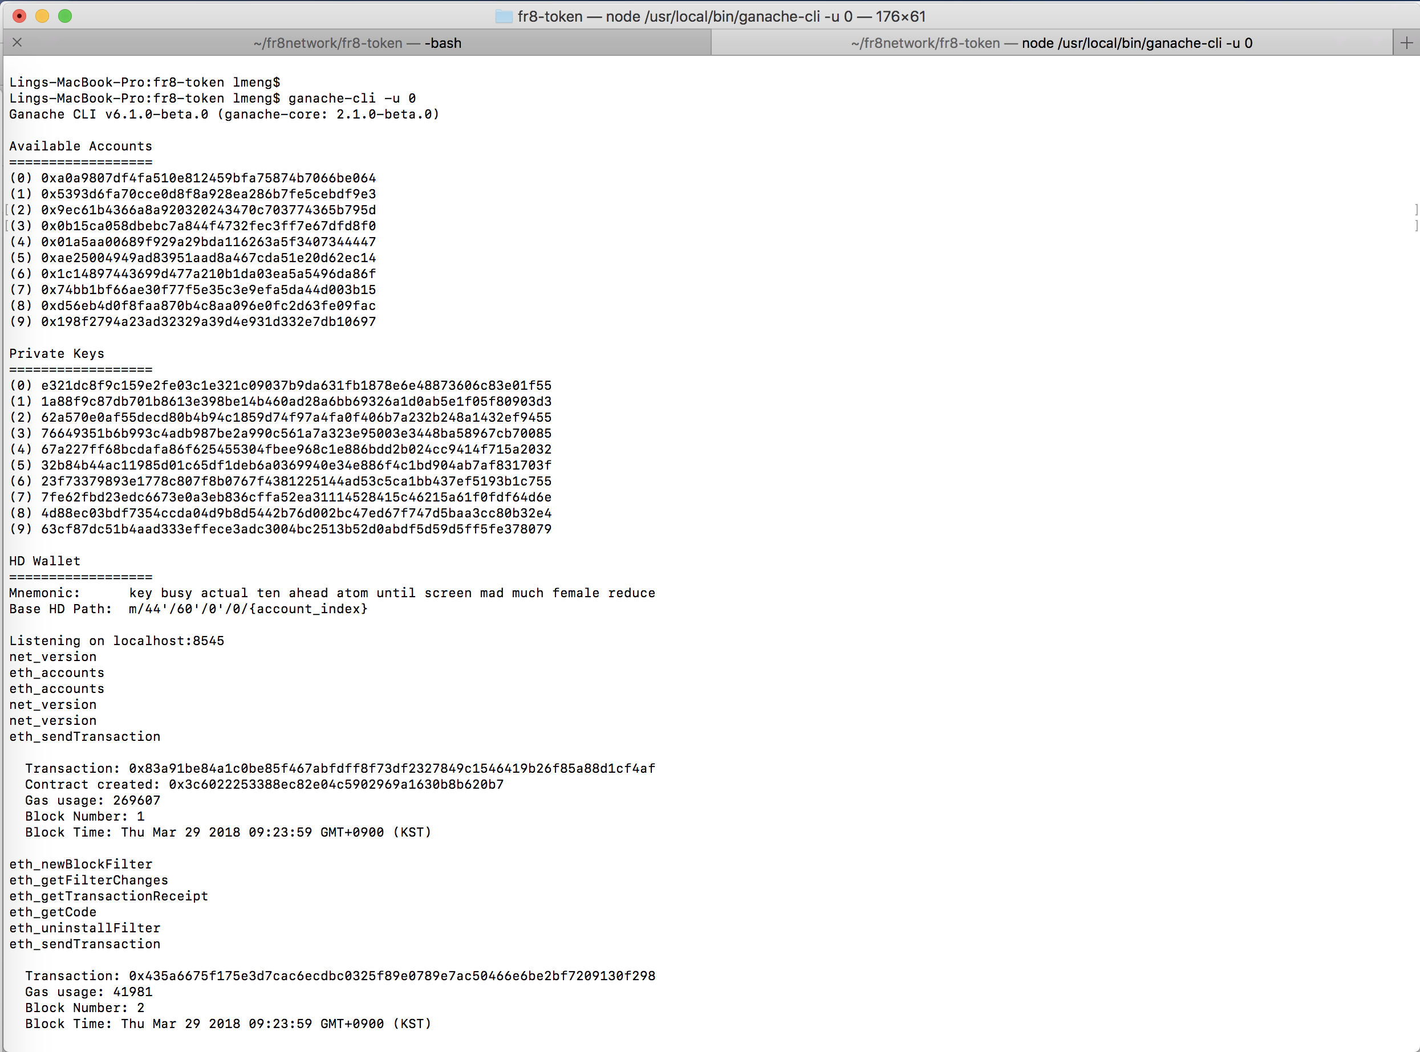
Notes:
Explain what happens in the blockchain on ganache

Slide 24
Notes:
Unlocking a wallet is something you can do in Metamask, Geth and Parity.

Slide 25
MIGRATIONS WITH TRUFFLE
Deploy on truffle to ganache-cli today
Git clone this now: https://goo.gl/nM25gm
Ganache-cli -u 0
truffle compile
truffle migrate
truffle migrate --network development --compile-all --reset
Notes:
What is ganache-cli What is -u, unlock first user
Web3, the api you use, has 10 accounts when you run it. It’s labeled with a 0 indexed array. So 0 is the first array element. That is the default account. It is the one that gets signed, the guy who pays all the gas, the guy that pays all the bills. Remember in metamask, you had to sign it every time you do something? Imagine if your OS prompted you to do that each time in this massive migration script, what a hassle!
It’s also the same account that your ether goes to if you’re mining ether. But then it would be called coinbase.
What is zero.
Unlocking a wallet is something you can do in Metamask, Geth and Parity.
https://goo.gl/nM25gm

Slide 26
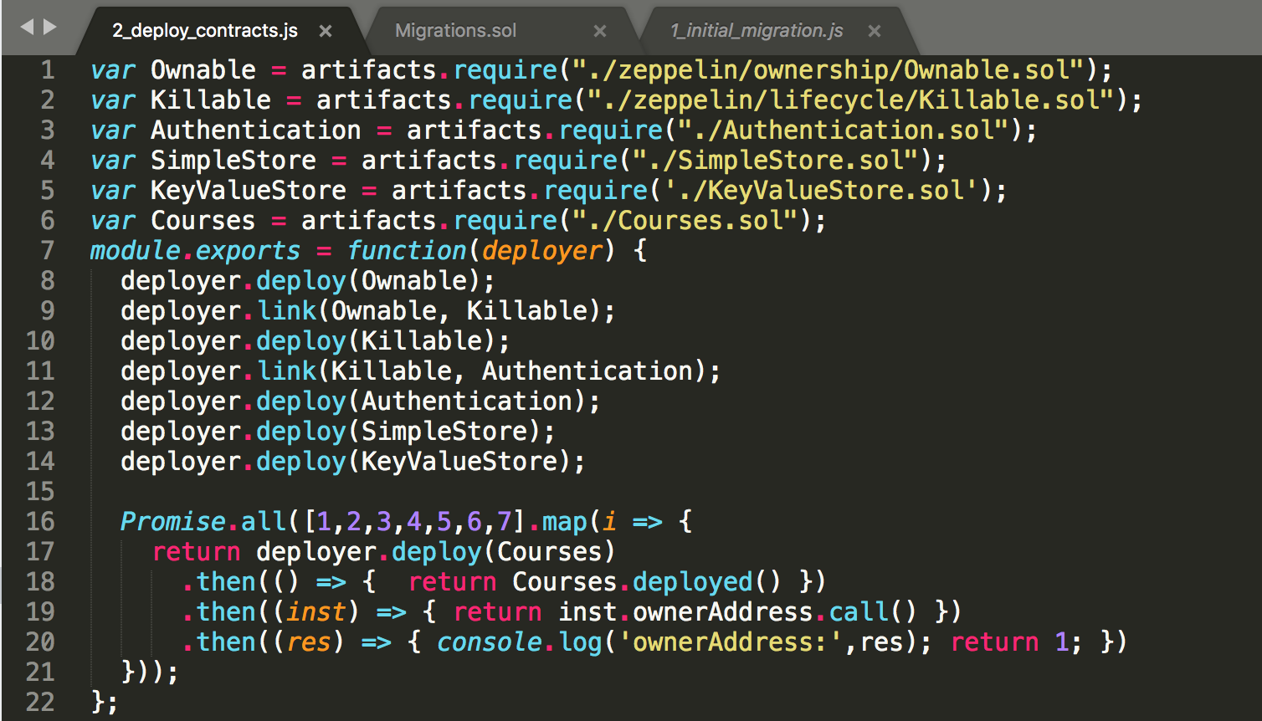
Notes:
The Migrations contract stores (in last_completed_migration) a number that corresponds to the last applied "migration" script, found in the migrations folder. Deploying this Migrations contract is always the first such step anyway. The numbering convention is x_script_name.js, with x starting at 1. Your real-meat contracts would typically come in scripts starting at 2_....
So, as this Migrations contract stores the number of the last deployment script applied, Truffle will not run those scripts again. On the other hand, in the future, your app may need to have a modified, or new, contract deployed. For that to happen, you create a new script with an increased number that describes the steps that need to take place. Then, again, after they have run once, they will not run again.

Slide 27
Cryptographic hash functions have different mathematical foundations, but they have the same property: they're easy to compute going forward (calculate H(x) given x), but practically impossible to compute going backward (given y, calculate x such that H(x) = y).
In fact, one of the signs of a good cryptographic hash function is that there is no better way to find x than trying them all and computing H(x) until you find a match.

Slide 28
LET’S REVIEW SOME CONCEPTS
Geth
Full Node, can do anything and everything on the Ethereum Network.
Mining, signing transaction, CLI wallet, web3 interface.
Written in Go.
Parity
Full Node, capable of mining. Unique that it has a GUI and has mining and can sign your transactions.
Written in Rust Javascript.
Faster at syncing.
Truffle HD Wallet
Probably most useful for developers if they need to connect to mainnet ASAP.
Connection goes from your 12 word seed phrase to your Metamask client, which then connects to Infura API, which then connects to a fully synced Geth or Parity.

Slide 29
INSTRUCTIONS FOR USE
Teams
Real life Developers work in teams, there will be a backend, frontend, and now blockchain team.
Since blockchain is single source of truth, all things are dependent on that.
Skilled blockchain developers are also the most expensive in the industry right now.
Teams need to be able to work async.
You’ll need
Truffle:
Ganache-cli:

